Slide 1
ADVANTAGE AUSTRIA
Austria’s Internationalisation Agency
Konferenca: Urejanje trga za lesne proizvode in storitve, Ljubljana 12.5.2014
Dr. Damijan Habernik, ADVANTAGE AUSTRIA

Slide 2
Contents
Importance of exports to the Austrian economy
ADVANTAGE AUSTRIA — Who are we?
What do we do?
advantageaustria.org – the online platform

Slide 3
Austrian Exports to Eastern Europe 2013 (preliminary data)
in thousands of EUR
Source: Statistics Austria

Slide 4
The Value of Exports to the Austrian Economy
EUR 125.4 bn export of goods 2013 (preliminary data)
EUR 130.0 bn import of goods 2013
47,000 exporters: 10% of all Austrian companies
56.7 % export sales ratio: 6 in every 10 EUR
USD 20.134 export per capita: world’s 7th largest exporter
Sources: 1) Statistics Austria, 2) AWO, 3) UNO, 4) WTO

Slide 5
Austrian Exports 2000-2013 (2013 = preliminary data)
Source: Statistics Austria, WIFO
Source: Statistics Austria, WIFO

Slide 6
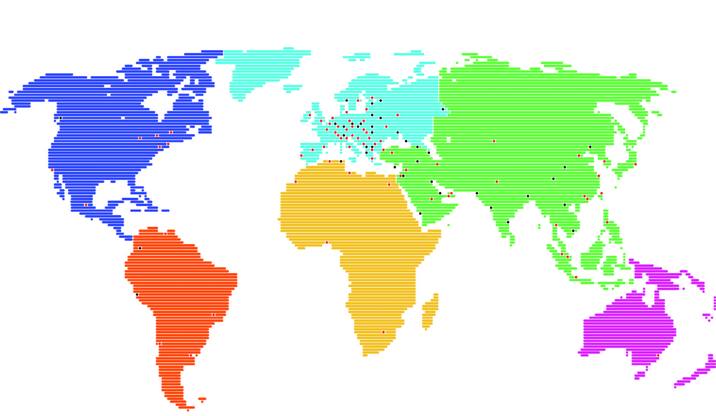
Austria‘s Export Destinations
Rest of Europe 6.2 %
EU 68.1 %
Asia 9.3 %
EFTA 5.9 %
Africa 1.3 %
America 8.4 %
Australia &
Oceania 0.7 %

Slide 7
Austrian FDI in Eastern Europe
 | Investor Ranking | Total Inward Investment (in EUR billion) | Austrian Share % | Latest available data
Slovenia | 1 | 11.7 | 48.9 | 2012
Croatia | 1 | 23.9 | 29.2 | 2012
Bosnia-Herzegovina | 1 | 5.4 | 22.1 | 2012
Serbia | 1 | 14.8 | 17.1 | 2012
Romania | 2 | 55.1 | 17.5 | 2012
Bulgaria | 2 | 36.6 | 16.0 | 2012
Slovak Republic | 2 | 39.6 | 15.0 | 2012
Macedonia | 2 | 3.6 | 11.4 | 2012
Albania | 3 | 3.0 | 15.6 | 2012
Czech Republic | 3 | 93.2 | 13.2 | 2012
Hungary | 3 | 65.3 | 12.1 | 2012
Ukraine | 5 | 39.1 | 6.1 | 2012
Poland | 10 | 153.3 | 3.1 | 2012
Montenegro | 12 | 3.3 | 2.7 | 2012
Russia | 12 | 352.3 | 1.8 | 2012
Source: OeNB, Gabor Hunya: WIIW FDI Report 2013

Slide 8
ADVANTAGE AUSTRIA — Internationalisation agency for the Austrian economy
Encouraging international activities by identifying
business opportunities abroad
Supports cross-border commercial activities
Positions Austria globally as an attractive business
location and a reliable business partner

Slide 9
Market support –
at home & abroad
First point of contact
Evaluating the target market, market potential, reports, competition
General legal information, taxes, import procedure
Identifying potential distributors, sourcing
Organising business trips
Scheduling appointments, accompanied meetings service
Credit checks on foreign companies
Procurement, projects
Recruiting staff, finding specialists

Slide 10
Worldwide Business Support -Facts and Figures
400,000 companies / 47,000 export businesses
113 offices in 70 countries
750 employees
80 nationalities
1,232 ADVANTAGE AUSTRIA events
1,100 ADVANTAGE AUSTRIA publications
22,000 Austrian companies
60+ years’ experience
Global business support

Slide 11
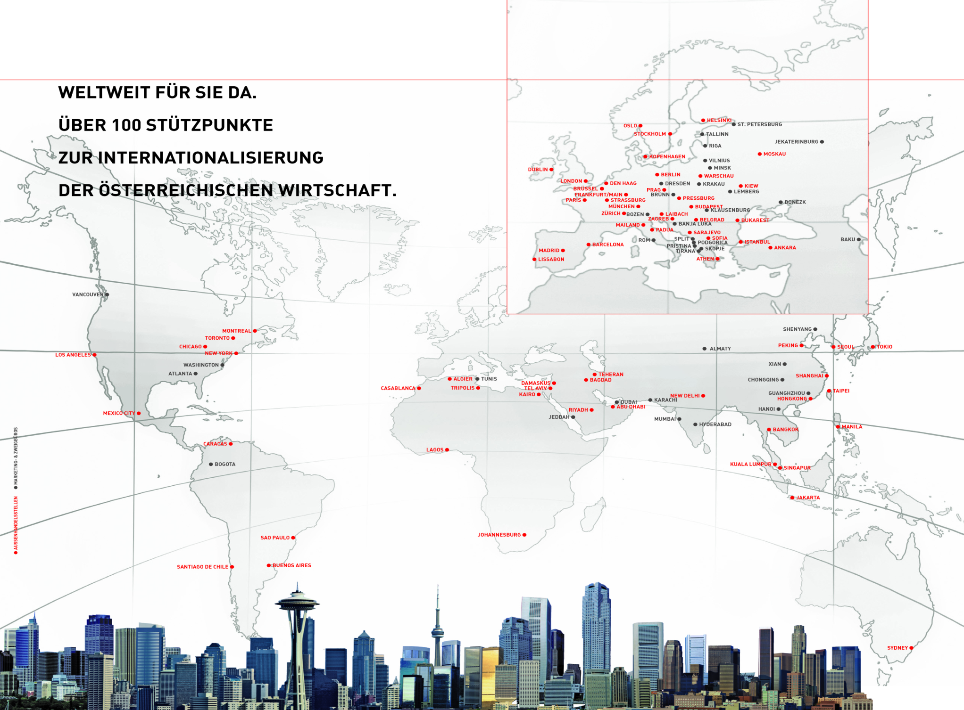

Slide 12
Number of exporters

Slide 13
ADVANTAGE AUSTRIA events
 | 2013
Austrian Pavillions | 118
Group Stands (Joint Booth) | 49
Trade Missions | 39
Fact-Finding Missions | 90
Forums | 226
Austria Showcases | 50
Catalogue Exhibitions | 80
Matchmaking Events | 79
Others | 501
Total | 1.232

Slide 14
www.advantageaustria.org
Austria’s Internet Platform — Overview
advantageaustria.org: 200 country sites (20 million hits)
28 languages (special focus on East European languages)
company presentations: 13,000 business opportunities
10 Content Partners
Listings of all events abroad with participating companies

Slide 15
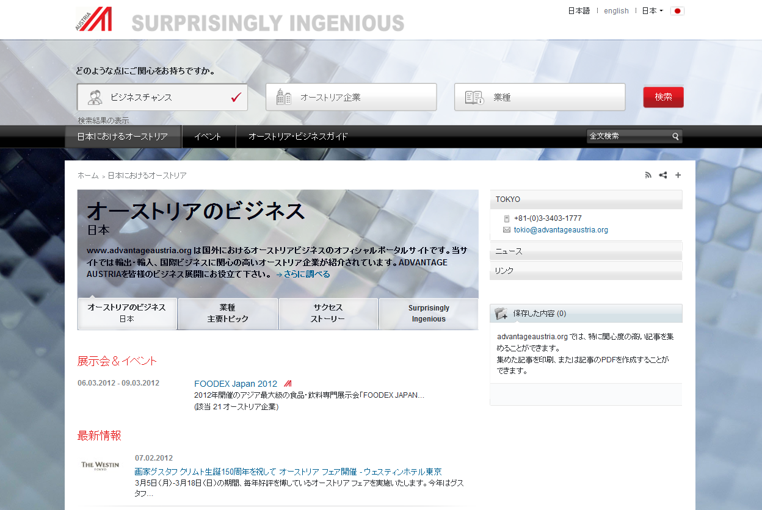

Slide 16
Any questions?
Dr. Damijan R. Habernik
ADVANTAGE AUSTRIA
Avstrijsko veleposlaništvo – gosp. oddelek
ljubljana@advantageaustria.org

